Slide 1
GNR - 638
Machine Learning for Remote Sensing - II
Team Members:
Aneri Modi (190100015)
Sai Bhargav Rongali (190100102)
Shwetambari Mali (190100071)

Slide 2
Problem the paper solves
Superresolution (SR) refers to the highly challenging task of estimating a high-resolution (HR) image from its low-resolution (LR) counterpart
Problem faced: For high upscaling factors, texture detail in reconstructed SR images is typically absent
Supervised SR algorithms commonly use an optimization target consisting of minimization of mean squared error (MSE) between the recovered HR image and the ground truth. This also maximizes the peak signal-to-noise ratio (PSNR)
PSNR is a common measure used to evaluate and compare SR algorithms
But, the ability of MSE (and PSNR) to capture perceptually relevant differences like high texture detail, is very limited as they are based on pixel-wise image differences
SRGAN solves this problem!

Slide 3
Motivation behind the paper
To solve the problem mentioned in the previous slide, the paper proposes a SR Generative Adversarial Network employed by using a Deep Residual network (ResNet) with skip-connection
Here, MSE is not the sole optimization target. Instead, the paper introduces a new perpetual loss using high-level feature maps of the VGG network, which are more invariant to changes in pixel space. This is combined with a discriminator that encourages solutions perceptually hard to distinguish from the HR reference images
Confirmed on the basis of MOS (Mean Opinion Score), SRGAN is the new state of the art, by a large margin, for the estimation of photo-realistic SR images with high upscaling factors (4×). This depicts the motivation of the paper in estimating HR images after upscaling.
Given an RGB image, we upscale the image by a factor of 4 i.e. an
image of size (24 X 24) would be scaled to size of (96 X 96)

Slide 4
Method used and possible solutions:
Interpolation
Auto Encoder
GAN
cv2.resize()
Interpolation type = cv2.INTER_LINEAR
Blurriness is caused to the up sampled image
Decoder can be used for Up sampling
Good for Upscaling factor of 2
Not efficient for a factor of 4 or more.
Poor quality images are obtained
LR image is feed to the Generator
Output of Generator is HR image
Works excellent in most of the Up sampling cases

Slide 5
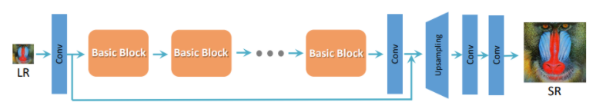
Experimental protocol -SR GAN
Based on the Paper – “Using GANs for Single Image Super-Resolution”
Basic structure includes Residual block and then upscaling is done.
Fig: Structure of the ResNet with upsampling

Slide 6
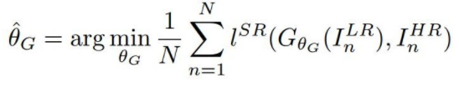
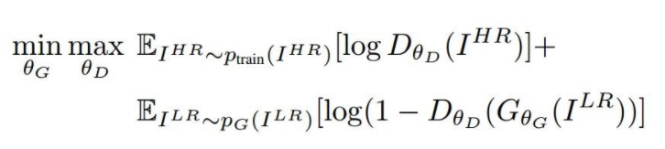
Experimental protocol
Generator
Discriminator
G: generator that takes a low-res image I^{SR}
θ_{G}: parameters of G, { W_{1:L}, b_{1:L} }
l^{SR} : loss function measures the difference between the 2 HR images
D: discriminator that classifies whether a high high-res image is I^{HR} or I^{SR}
θ_{D}: parameters of D

Slide 7
Training
Training dataset consisted of 8144 images. LR images were created using resizing the image using interpolation techniques - cv2.INTER_CUBIC in OpenCV
Number of Epochs – 2000
Loss – Binary Cross Entropy
Optimizer – rmsprop
Framework – Keras with Tensorflow as backend

Slide 8
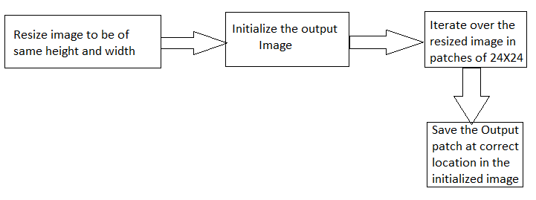
Testing

Slide 9
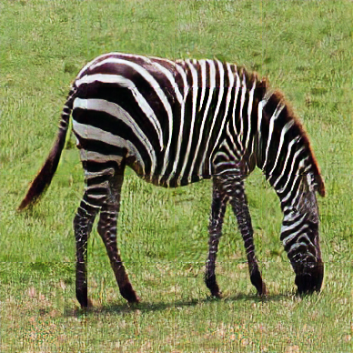
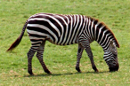
Results obtained:
LR
146 ✕ 97
HR
388 ✕ 388

Slide 10
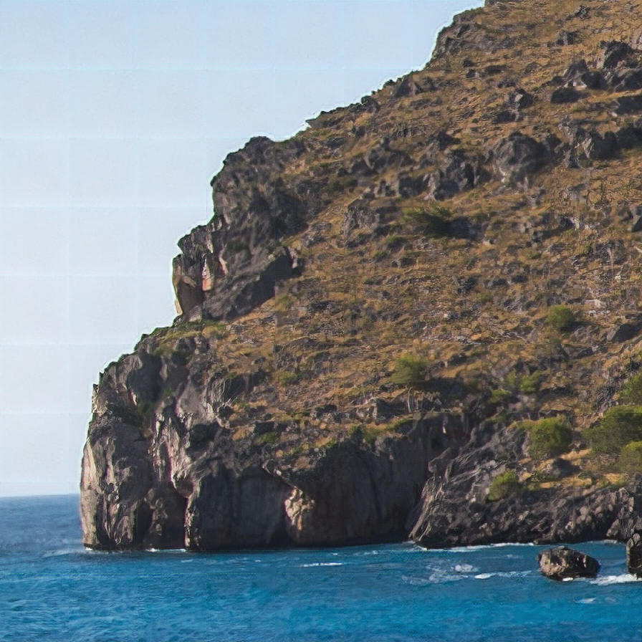
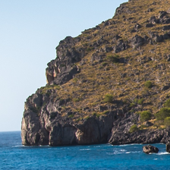
Results obtained:
LR
224 ✕ 2244
HR
896 ✕ 896

Slide 11
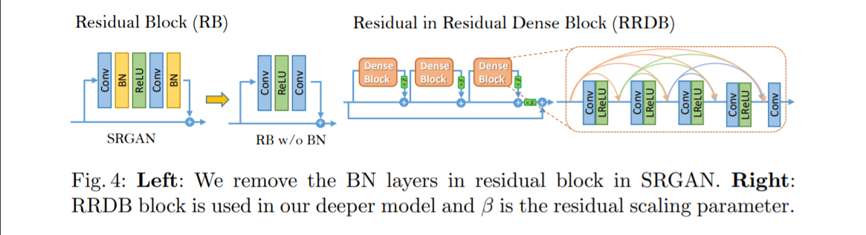
Further Improvement
In order to further improve the recovered image quality of SRGAN, we mainly make two modifications to the structure of generator G:
Remove all BN layers;
Replace the original basic block with the proposed Residual-in-Residual Dense Block (RRDB), which combines multi-level residual network and dense connections as depicted:

Slide 12
Training- Improved SRGAN
Training dataset consisted of 8144 images. LR images were created using resizing the image using interpolation techniques - cv2.INTER_CUBIC in OpenCV
Number of Epochs – 2200
Loss – Binary Cross Entropy
Optimizer – rmsprop
Framework – Keras with tensorflow as backend

Slide 13
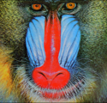
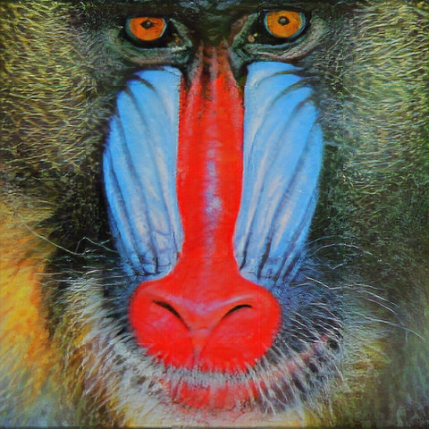
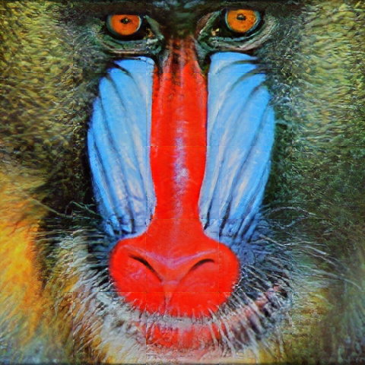
SRGAN
Improved SRGAN (ESRGAN)

Slide 14
Potential future directions:
Include computational efficiency along with the perceptual quality of super-resolved images as part of the objective.
To optimize the model for video SR in real-time.
Though it was found that deeper networks (B > 16) can further increase the performance of SRResNet, it come at the cost of longer training and testing times. A future work may be reducing this time consumption.
It was further found that SRGAN variants of deeper networks are increasingly difficult to train due to the appearance of high-frequency artifacts. A future potential work is possible in this area.
The ideal loss function depends on the application: Approaches that hallucinate finer detail might be less suited for medical applications or surveillance, which are high-stake activities. The perceptually convincing reconstruction of text or structured scenes is challenging and part of future work.
Content loss functions development that describe image spatial content, but more invariant to changes in pixel space, will further improve photo-realistic image SR results.

Slide 15
References
SRGAN Paper - https://arxiv.org/abs/1609.04802
ESRGAN Paper - https://arxiv.org/abs/1809.00219
Instructions to run our code:
Upload your Low resolution image in SRGAN/test/input and high resolution output will be generated in SRGAN/test/output (similar procedure goes for ESRGAN)
Start training: python train.py
For testing: python test.py
model.py consists of the SRGAN model code
.ipynb notebooks are also present for ease of access

Slide 16
THANK YOU!

